Slide 1
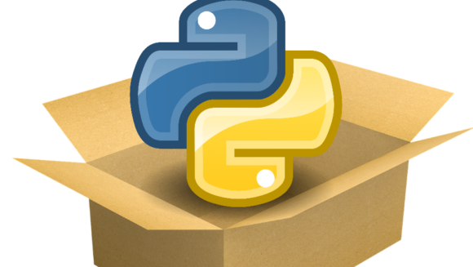
Welcome & Module Induction
What we learned previously: In Module 14, we built an automated "Safety Net" using testing and mocking to ensure our code is bug-free.
What we are learning today: We are going global. We will learn how to structure our code into a professional library, write its "Identity Card" (pyproject.toml), and publish it to the Python Package Index (PyPI).
Why this will be helpful: Think about the tools you use every day: numpy, pandas, torch, fastapi. These weren't just scripts; they were packaged. If you want your project to be used by other students or companies, you must provide it as an installable package.

Slide 2
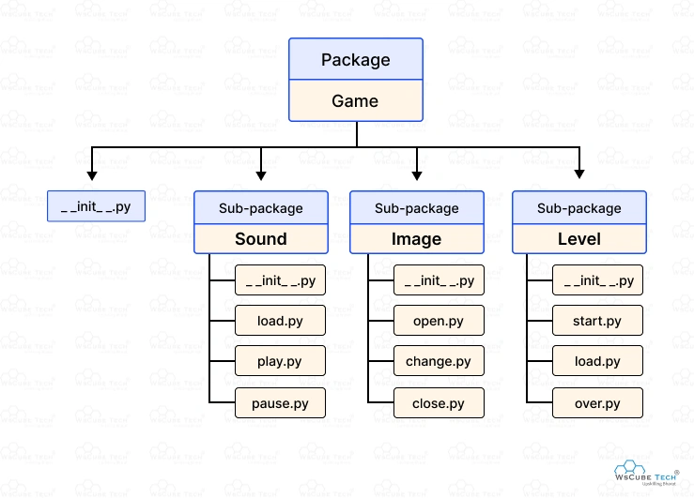
Library Structuring (The Blueprint)
The Problem: A single script is hard to share. If you have 5 files and 10 dependencies, your user will get lost trying to set it up.
The Solution: A standardized directory structure. We group our logic into a "Source" folder (src/) and separate our tests, documentation, and metadata.
The __init__.py file: This tiny, often empty file is the "Magic Key." It tells Python that a folder is not just a collection of files, but a Package that can be imported.

Slide 3
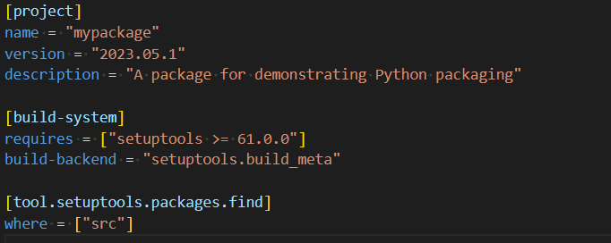
pyproject.toml (The ID Card)
The Modern Standard: In the past, developers used setup.py. Today, the world has moved to pyproject.toml.
The Contents: This file contains everything the world needs to know about your library:
Metadata: Name, Version (e.g., 0.1.0), Author (Zaryab Ahmad), and License.
Dependencies: What other libraries (like requests or numpy) does your code need to run?
Build System: Which tool should be used to compile your code (e.g., setuptools or poetry)?

Slide 4
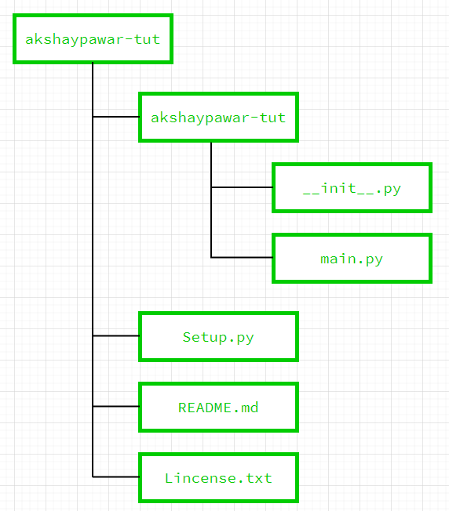
PyPI & Twine (The Delivery Truck)
PyPI: The "Python Package Index." This is the central warehouse where all Python software lives.
Twine: This is the secure "Delivery Truck" that carries your packaged code from your laptop to the PyPI warehouse.
The Result: Once uploaded, any person on Earth can open a terminal and type pip install your-package-name to use your work.

